Slide 1



Seminar on Public Financing for Children’s Rights
6th November 2024
Contact email: childrens.rights@ed.ac.uk

Slide 2
Seminar recording
Whole seminar recording (2 hours)

Slide 3
PURPose of this SLIDE Pack
This pack collates slides and links to speaking notes from the seminar on Public Financing for Children’s Rights which took place on 6 November 2024.
The seminar was a collaboration between the Improvement Service’s UNCRC Implementation project and the Observatory of Children’s Human Rights Scotland.
The seminar was recorded: https://media.ed.ac.uk/media/1_q6l2m8js.
Notes of the group discussions, which were not recorded, can be found in this pack, alongside links speaking notes and further information.
The Observatory is thankful to the Royal Society of Edinburgh for funding our Research Network on Children’s Human Rights and through this Network, our tackling of this complex challenge for children’s rights implementation.

Slide 4
Welcome
Dr Debby Wason, Honorary Fellow, Moray House School of Education and Sport, University of Edinburgh

Slide 5
Programme of the seminar
2.00 – 2.15pm | Welcome & Introduction
2.15 – 3.10pm | Presentations and Q&A
3.10 – 3.30pm | Break
3.30 – 3.45pm | Reflections from the Action Inquiry into Children’s Rights Budgeting at Local Authority Level
3.45 – 4.20pm | Group discussions
4.20 – 4.45pm | Feedback
4.45 – 5pm | Final reflections & close

Slide 6
Introductory remarks
Seminar Chair
Professor Graeme Roy, Professor in Economics, Glasgow University
Link to relevant recording

Slide 7
Child Rights Budgeting: Delivering Dignity and Respect
Professor Jo Ferrie, Professor of Sociology, Glasgow University
Link to relevant recording

Slide 8
The UNICEF model: Public Financing for Children (PF4C)
Alberto Musatti, Social Policy Specialist (Public Finance), UNICEF Regional Office for Europe and Central Asia
Link to relevant recording

Slide 9
Child Rights Budgeting
UNICEF Regional Office for Europe and Central Asia
Social policy / public finance & local governance
Alberto Musatti

Slide 10
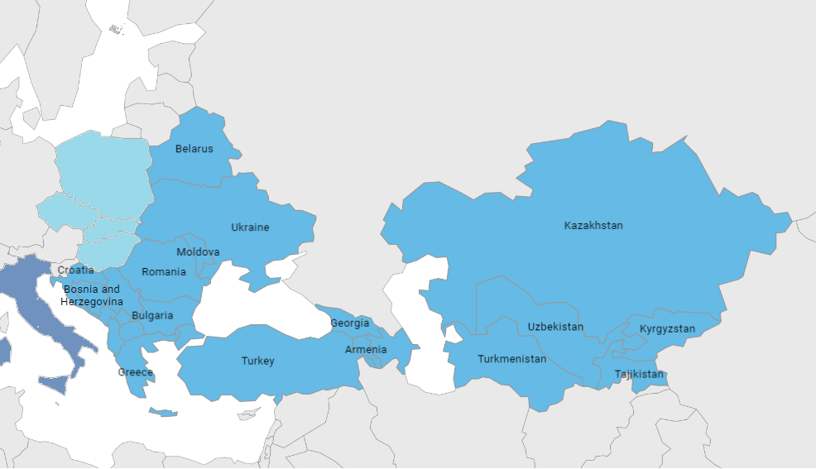
Europe and Central Asia Region

Slide 11

CRC’s Article IV
With regards to economic, social and cultural rights, States Parties shall undertake all appropriate legislative, administrative, and other measures for the implementation of the rights recognized in the present Convention, to the maximum extent of their available resources and, where needed, within the framework of international co-operation. (…)
Appropriate measures?
Maximum extent?
Available resources?

Slide 12
* Contextual Elements *
When compared to other regions of UNICEF
This region has better records in budget transparency
Use data, analyze, highlight what is missing
High public spending as a share of GDP; high social protection
Identify what is child specific
Limited - but potential and increasing –
private sector’s engagement
Consider the private sector or HHs
Higher de-concentration, higher decentralization especially
in social spending
Articulate on the action in the local governance contexts

Slide 13
Objective and Expected Result
GENERAL OBJECTIVE
A planning and budgeting process that is fully considerate of the needs and costs required for the fulfillment of child rights
SPECIFIC OBJECTIVE (UNICEF)
A) Accurate data > inputs, B) timely delivered, C) to the right stakeholder

Slide 14
3 Questions to Answer
How much is a country spending for children?
How much should a country spend on children?
What are the financing options?
> Resource mobilization strategy
What is the gap?
Advocacy

Slide 15


Key Enablers
Set-up a process over the mid-term
Having MoF as part of the conversation
Accompany in parallel with monitor progresses of the situation of children

Slide 16

3 Steps
Step I - Measurement
Step II – Prioritization and Costing
Step III – Financing Options and Resource Mobilization
Conduct a measurement / monitoring of public spending for children
Possibly
- Based on a costed child rights strategy
- Using a tagging system / automated reporting
- Using a programmatic classifier
…
regional guidance
Identify the cost required to fulfill child rights
Possibly, as a top-down approach
Via costing of CRC realization
Via costing SDGs achievement
Alternatively, as a bottom-up approach via costed child rights strategy, programmes, etc…
(regional reflection under development)
Identify and associate the traditional financing options, look for additional fiscal space, including no-public
Financing social protection
ECD financing
…
Elaborate a multi-year financing plan

Slide 17
How does this articulate in LG
GENERAL OBJECTIVE
A planning and budgeting process that is fully considerate of the needs and costs required for the fulfillment of child rights
SPECIFIC OBJECTIVE (UNICEF)
A) Accurate data > inputs, B) timely delivered, C) to the right stakeholder
Local data – equity focus / equalization
Capacity building
Local participatory processes
A clear division of labor (finance, functions) on service provision

Slide 18

Limitations
Regionally adapted
Focus on budget formulation process (“spending more”)
Missing elements to contribute improving budget execution and monitoring (“spending better”)
Weak links between central and local work

Slide 19
Q1/2 2025 - Regional exchange
Regular monitoring of public spending for children – Italy, Spain, UK, Jersey
Thematic budgeting – the systematic analyses of budget allocations and public spending as seen through different and complementary “lenses”, including children (eg gender, child, climate…) – Ireland
Comprehensive costing – child rights strategy – Finland
Introducing the child tag in an information management system – Turkiye
Assessing the impact - Strategic Integrated Impact Assessment (SIIA) / Child Rights Impact Evaluation (CRIA/CRAG) - Wales

Slide 20
Thank you
amusatti@unicef.org

Slide 21
Programme Budgeting: A potential model for CRB?
Professor Neil Craig, Professor of Public Health Economics, Glasgow Caledonian University
Link to relevant recording

Slide 22
Programme Budgeting: A potential model for CRB?
Neil Craig
Professor of Public Health Economics
Yunus Centre for Social Business and Health
Glasgow Caledonian University

Slide 23
Outline
Does programme budgeting offer a useful tool to support Child Rights Budgeting (CRB) in Scotland?
What do we need?
What can programme budgeting offer?
What can’t it do?
Summary
Notes:
I want to start with the question that perhaps we can consider later in the discussion.
I then want to offer some thoughts that might help us answer that question:
What do we need to do in order to develop and do CRB in an informed and democratic way?
What can programme budgeting offer?
What can’t it do? I want to be very clear on that because it is certainly not a panacea or quick fix, but I suspect no such things exist in this context.
Summary

Slide 24

Notes:
Thinking through what might help with CRB, I was struck by some of the things said in this document.
So I’m going to spend a few minutes picking out some things from it that I think are particularly relevant to a discussion around PB and CRB.

Slide 25
Article 4 UNCRC:
“obligation to guarantee that budgets are mobilised to realise children’s rights, as the implementation of rights has much to do with how governments generate, allocate, and spend their resources.”
“children’s economic, social, and cultural (ESC) rights … are more resource-dependent than civil and political rights.”
“states’ financial resources, as reflected in their budgets, are critical to fulfilling children's ESC rights.”
Notes:
Firstly, it points to Article 4 of the UNCRC, which stresses that
states are under an “obligation to guarantee that budgets are mobilised to realise children’s rights, because the implementation of rights has much to do with how governments generate, allocate, and spend their resources.
The document suggests that
“…the realisation of children’s economic, social, and cultural (ESC) rights …are more resource-dependent than civil and political rights, which I interpreted as meaning that upholding children’s ESC rights is about things like tackling poverty, ensuring equal access to good education and health care for all children, providing good social work services when they are needed etc.
“Therefore, states’ financial resources, as reflected in their budgets, are critical to fulfilling children's ESC rights.

Slide 26
Highlights the importance of knowing where resources are currently going
“Identify direct and indirect allocations for children in the budget.
CRC: “no state can claim that it is fulfilling children’s ESC rights unless it can identify the proportions of its national and other budgets that are allocated to children.”
To the maximum extent of, but within, available resources
Available resources not fixed or static. They reflect policy choices for which Scottish Government and public bodies are responsible.
Notes:
It follows from that, that to deliver this obligation, it is important to know where resources are currently going. CRBiS points to the need to “identify direct and indirect allocations for children in the budget.” This does not necessarily separate budgets for children, but budgets need to be able to identify how much of the spend goes to children to uphold their rights.
It goes further in stating that under the Max. Available Resources Principle of the CRC, “no state can claim that it is fulfilling children’s ESC unless it can identify the proportions of its national and other budgets that are allocated to children.”
It suggests that the CRC requires that states allocate the maximum possible whilst recognizing resources aren’t limitless.
This doesn’t mean available resources should be seen as fixed or static. They reflect policy choices for which Scottish Government and, within spending areas, public bodies are responsible.
Where additional resources are required to put in place what is agreed to be required to uphold children’s rights, those resources should be found.
Of course, they need to be found from somewhere so there will be opportunity costs that need to be considered in delivering on the rights of children.
An issue I noticed was raised in the Speaker Briefing:
1. Budget holders feel the need to balance the needs of various population groups within their budgets
2. Budget holders need to balance the fulfilment of rights with other statutory responsibilities eg waste collection

Slide 27
Principles – regarding outcomes of budgeting process
The CRC identified five general budget principles for children’s rights:
Effective
Efficient i.e. effective in relation to cost
Equitable i.e. fair
Transparent
Sustainable
“Every budgetary decision must reflect these principles.”
Notes:
On top of the preceding guiding principles, the CRC also identified five general budget principles for children’s rights: effectiveness, efficiency, equity, transparency, and sustainability.
Every budgetary decision must reflect these principles. p.13
Which implies some process or processes need to be in place to ensure they do.

Slide 28
Principles regarding the process itself - TAAPE
Transparent
Accessible
Accountable
Participatory
Empowering
“Formulating the budget is more than a technical exercise.”
Notes:
That process needs to be TAAPE:
Transparent (clear how and why decisions were taken)
Accessible (to those affected i.e. children)
Accountable
Participatory (involving key stakeholders)
Empowering (involving them in ways that enable them to influence the decisions made)
“Formulating the budget is more than a technical exercise.”
i.e. it is not just the final budgets derived but the process by which they were derived, and whether it met these CRB principles

Slide 29
So what’s needed?
A way of understanding where resources are currently going in relation to rights-relevant programmes
A deliberative process for:
- defining rights-relevant programmes
- evaluating current programmes
- identifying potential changes
- evaluating potential changes
- in a systematic, transparent and democratic way
Notes:
Pulling all this together, what do we need to support CRB?
Firstly, a way of understanding where resources are currently going in relation to rights-relevant programmes
Secondly, a deliberative process i.e. a process that involves key stakeholders in discussions about:
- defining rights-relevant programmes – i.e what programmes need to be in place with adequate resources to uphold children’s rights
- evaluating current programmes – How much resource currently goes to each of these programmes? Is it enough e.g. in relation to need? Are they the right programmes to uphold children’s rights?
- identifying potential changes – If the answer to the preceding question is no, how might we change the budgets and what they are spent on?
- evaluating potential changes – in terms of their costs and their benefits, i.e. assessing whether the suggested changes to budgets would do more than current programme budgets to uphold children’s rights.
- in a systematic, transparent and democratic way – the process is important, for reasons of accountability and participation, as well as to bring a range of perspectives to bear on how resources are ultimately allocated

Slide 30
What is programme budgeting - PB?
A way of describing the resources spent, within a programme or across a number of relevant programmes
Programmes relate to particular groups or other categories of policy interest
In relation to information on needs and activity…
…To begin to raise questions about whether the right programmes of the right size are in place.
Often advocated in tandem with ‘marginal analysis’
Notes:
A way of describing the resources (or costs) spent, within a programme (such as health care) or across a number of relevant programmes (such as health care, education, social work, social security).
Where programmes relate to particular groups of interest, such as age groups, or socio-economic groups, to geographical areas, or to other categorisations of policy interest e.g. prevention
In this context, relevant programmes are those required to uphold childrens’ rights.
Which then need to be judged in relation to information on needs and levels of service provision
To begin to raise questions about whether the right programmes of the right size are in place.
Often advocated in tandem with ‘marginal analysis’, which I’ll come back to in a mo.

Slide 31

Service Budgets - INPUTS
Education |  | Health care |  | Social services
Teachers | Buildings | Doctors | Medicines | SWs | Carers
£X | £Y | £Z | £A | £B | £C | Total
Notes:
Involves reclassification of functional or input-based budgets towards programme budgets where programmes reflect policy interests.
Explain schematic.

Slide 32
 |  |  | Service Budgets - INPUTS
 |  |  | Education |  | Healthcare |  | Social services
 |  |  | Teachers | Buildings | Doctors | Medicines | SWs | Carers
Programme Budgets - OUTPUTS | Children | 0-5 | £XD |  |  |  |  |  | £D
 |  | 6-17 | £XE |  |  |  |  |  | £E
 | Adults | Working age | £XF |  |  |  |  |  | £F
 |  | Elderly | £XG |  |  |  |  |  | £G
 |  |  | £X | £Y | £Z | £A | £B | £C | Total
Notes:
Programmes based on the areas of policy interest, which might be different socio-economic groups, different geographical areas, different functions such as prevention rather than treatment, or different age groups. i.e programmes reflecting what or who we are using the resources for, not just the inputs we are spending that money on.
Disaggregation is required to estimate how existing budgets are allocated across programmes, so for the £X spent e.g. on teaching, that would require disaggregation by e.g. age group, which for some inputs would not be straightforward, but (arguably?) it is possible with enough detail and accuracy to be useful.

Slide 33
What is marginal analysis – MA?
    Involves assessing the costs and benefits of proposed changes in the PBs
    Recommends changes in the way services are delivered if benefits to the population overall will be increased
Notes:
Involves assessing the costs and benefits of proposed changes in the PBs – variety of info used to do that
Recommends changes in the way services are delivered, if benefits to the population overall will be increased
We can come back to that – how and with what info – in the discussion if that’s of interest

Slide 34
PBMA – not just a technical exercise
It’s a process, and the process is important
It needs to involve stakeholders, in:
- defining rights-relevant programmes
- agreeing possible changes
- agreeing criteria against which to assess them
- scoring or ranking options
- reviewing and validating the process
Many examples of the use of PB and MA have done that
Notes:
The process involved in PBMA is important. It is not, to repeat the phrase from CRBiS just a technical exercise
It needs to involve people affected and people responsible for delivery i.e. stakeholders, in
– defining rights-relevant programmes and their objectives
agreeing possible changes
agreeing criteria against which to assess these changes
scoring or ranking options
reviewing and validating the process
Many examples of the use of PB and MA have done that, usually with positive feedback on the process, but also with challenges.

Slide 35
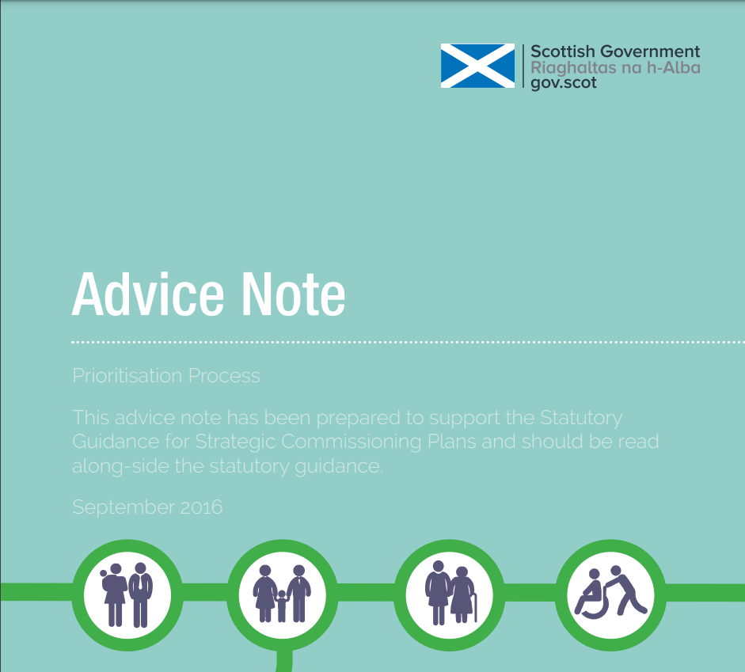
Notes:
And it was advocated a few years ago by SG in this Advice Note to support the Statutory Guidance for Strategic Commissioning Plans of within the new arrangements around H&SCPs.
They faced similar issues in terms of clarifying how resources were currently being used in relation to different user and other stakeholder groups, and whether re-allocation might yield more benefit from available resources.

Slide 36
PBMA is not:
A precise accounting process
A short cut to re-allocating resources to different uses
A quick fix
  Evidence-informed deliberative processes are time consuming
  Need buy-in of staff
  A technical solution to an essentially political set of issues
Notes:
In summary, PBMA is not:
A precise accounting process – data difficulties, need to be pragmatic, the aim is indicative information about where resources are going – indications reliable enough to raise pertinent questions?
A short cut to re-allocating resources to different uses – can this be achieved? - Be realistic about the scope to move resources around
A quick fix
Evidence-informed deliberative processes are time consuming, for technical and political reasons
Need buy-in of staff, including senior staff to provide the organisational commitment to do things in this way, given the time commitment
A purely technical solution to an essentially political set of issues - differing perspectives and contested evidence are likely but decisions still have to be made, and will be made – so a question for discussion is whether something like PB, with or without MA, can help make do CRB in an informed and democratic way that might improve those decisions in a way which ensures we do as much as we can to uphold children’s rights.

Slide 37
Conclusion: PBMA can be…
An explicit, transparent process
For structuring thinking and dialogue around resource allocation and options for change
In a way that can involve stakeholders
Incorporating economic principles – finite resources, opportunity cost, marginal costs and benefits of proposed changes
And principles of procedural justice and ‘accountability for reasonableness’

Slide 38
References
Collins, M., et al. 2023. Developing a combined framework for priority setting in integrated health and social care systems. BMC Health Services Research. 23(1), pp.1–879. Available from: 10.1186/s12913-023-09866-x.
Scottish Government. 2016. Advice note: Prioritisation Process. https://www.gov.scot/binaries/content/documents/govscot/publications/advice-and-guidance/2016/09/advice-note-prioritisation-process/documents/00505886-pdf/00505886-pdf/govscot%3Adocument/00505886.pdf
Collins, M., et al, Developing priority setting processes in Health and Social Care Partnerships: learning from the pilot sites. https://www.scotphn.net/wp-content/uploads/2015/11/Priority-setting-in-Health-and-Social-Care-Partnerships.pdf

Slide 39
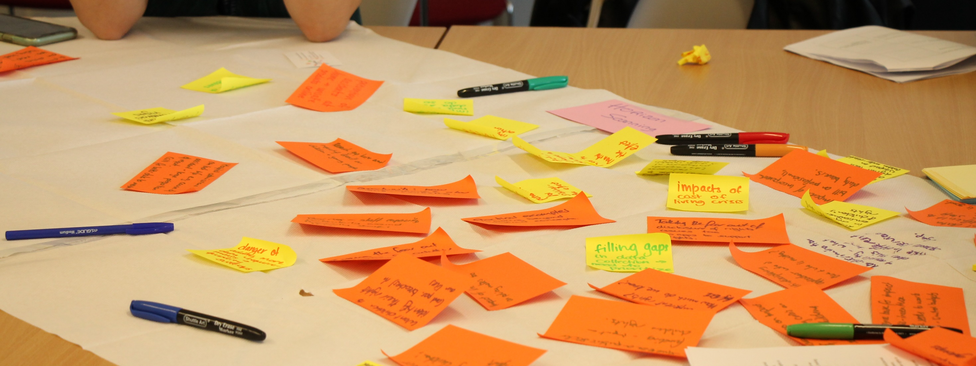
Q&A

Slide 40
Questions for PANEL
Link to relevant recording
How can we work out appropriate costings for interventions around children’s rights?
Alberto: The IMF has undertaken some work on this. It is important to ascertain what is the desired outcome and work back from that in steps. Then calculate how much each step would cost.
Who should be responsible for implementing children’s rights - surely central government should take the lead?
Alberto: Both local and central government are crucial to achieving rights for children but they need to work closely together.

Slide 41
Questions for Panel contd
It can be very difficult to get accurate costings for interventions. So how we know how much achieving children’s rights will cost?
Neil: It is possible to cost interventions accurately with the appropriate data. So accurate data is vital. However even without detailed data often a realistic estimate can be obtained.
What does Prof Ferrie mean by ‘beyond data’?
Jo: We need data but we also need to test that data for relevance and authenticity. This is where participation comes in. We need to check we have the data we need now to pursue children’s rights

Slide 42
Reflections from the Action Inquiry into Children’s Rights Budgeting at Local Authority Level
Rebecca Spillane, Project Manager – UNCRC Implementation, Improvement Service
Martin Booth, Executive Director of Financial Services, Glasgow City Council
Link to relevant recording
Link to relevant recording

Slide 43
Group Discussions

Slide 44
Group Discussions
Link to recording of the groups’ feedback
Attendees were sorted into groups by type of organisation (local authorities, health boards and national public bodies).
They were asked to first discuss the obstacles to implementing a child rights budgeting (CRB) approach in their organisation/sector. This discussion was supported by the “concerns commonly raised for discussion” slide.
They were then asked to talk about potential solutions, responding to the following prompts:
  What needs to happen for CRB to be implemented in your sector/organisation?
  What can you do to support CRB in your organisation and what support do you need from others?

Slide 45
CONCERNS COMMONLY RAISED for Discussion
Budget holders feel the need to balance the needs of various population groups within their budgets & the fulfilment of rights with other statutory responsibilities (e.g. waste collection).
Children’s Rights Impact Assessments (CRIAs) need to be integrated into other Impact Assessments in order to mainstream children’s rights and for the sake of efficiency.
Budget holders would appreciate more detailed guidance from central government on the detail of budgetary allocations.
Budget holders are concerned that without further guidance they may be exposed to litigation on the basis of children’s rights being unmet.
Current budgeting process are short-term focused and siloed. Budget holders would appreciate being able to learn from others and given time to embed any new budgeting processes.
Severely limited resources mean budget holders cannot undertake new processes which are resource intensive unless further support is available for this purpose.

Slide 46
Summary of the Obstacles Raised by the Groups
The Budgeting process leaves very little time to really consider priorities and make decisions.
The process also does not allow space to conduct CRIAs in a meaningful manner and within a timescale which can feed into budget decisions.
Budgets are often based on previous budgets with a few tweaks rather than looking at the evidence of what works and forming the budget around that.
Yearly budgets mitigate against long term planning. A 5 to 10 year planning process with budgets attached needs to be the norm.
The election process mitigates against long term planning and budgeting.
It is hard to stop funding a service which has previously been funded.

Slide 47
Obstacles Cont’d
Budgets sometimes appear to be confirmed but then are cut – sometimes apparently arbitrarily so confidence in the system is lost. It is also hard to then keep the service going.
There are multiple priorities e.g. climate change, social care, children etc. How do we know what to prioritise? Children are affected by everything so realising their rights means prioritising everything.
Do we really understand children’s needs adequately?
We need an evidence base of what gives the best value for money in developing services for children.
We need to work more collaboratively as the public sector. And we need to know how to effectively involve people in the decisions that affect them.

Slide 48
Obstacles cont’d
There is a lack of policy coherence around children. We need to articulate the desired outcomes and then cost them step by step.
Scottish Government (SG) tends to give local authorities and health boards a long list of required actions without the resources to achieve those. So we need a national plan and national priorities. This needs to be based on the right voices being heard.
Accounts and accounting at both national and local level are complex and often opaque.
Nationally there needs to be a discussion as to how to match funding to the service levels required. There is a lack of transparency from national government as to how funding transfers are calculated.
Clear guidance for Child Rights Budgeting therefore needs to come from Scottish Government.

Slide 49
SUMMARY OF THE POTENTIAL Solutions Suggested by Groups
Map outcomes data to current spend to ascertain where the areas of biggest spend but possibly fewest desired outcomes are.
Develop a way to prioritise actions which are used across the public sector.
Make possible and develop a culture of data sharing across the public sector.
Use the concept of Progressive Realisation, i.e. concentrate on a few priorities at a time with a view to slowly realising rights over time. Don’t try and do everything at once.
Collectively decide whose rights and what type of rights need to be addressed first.

Slide 50
Solutions cont’d
Strengthen peer support across the public sector in this area.
Ensure CRIAs are done in an influential and timely manner to feed into the budgetary process.
Presently we are always planning in a crisis. Shift the thinking and start planning more long term. Shift the budgetary process to allow more time for planning.
Ring fenced money is not always ring fenced for the most appropriate service so more discretion should be allowed for example money might be ring fenced for teachers but what is needed is more school transport.

Slide 51
Solutions cont’d
Ring fencing isn’t always based on evidence. Develop an evidence based approach to ring fencing and only do so where necessary.
Change the audit approach to a more performance based auditing so that expenditure is measured more by the achievement of desired outcomes.
Might be useful to look at the example of Italy where all Local Authorities services are based on statute so there is little conflict between local and central government.

Slide 52
Closing Remarks
Seminar Chair
Professor Graeme Roy, Professor in Economics, Glasgow University
Link to relevant recording

Slide 53
THANKS
Professor Kay Tisdall, Chair of Childhood Policy, Moray House School of Education and Sport University of Edinburg

Slide 54
Thank you for attending This SEMINAR!
Contact email: childrens.rights@ed.ac.uk

