Slide 1

Understanding children’s ‘accommodation’ of parental separation and divorce
Moray House School of Education and Sport
Dr Sue Kay-Flowers
Email: S.J.Kay-Flowers@ljmu.ac.uk

Slide 2
Research Design: determined through focus group discussions with young people
Focus of research study: giving ‘voice’ to young adults’ everyday childhood experiences of parental separation and divorce
Sample: young adults aged 18-30 who had experienced parental separation in childhood

Slide 3
Research design: focus group decisions
Internet
Online questionnaire
Short video clip on YouTube website

Slide 4
Working with young people to create a bricolage
‘Bricolage’ – where current methods are unsuitable for addressing the research questions and different tools need to be invented
(Denzin and Lincoln, 2011)
Co-creation of specific research tools:
i. Short video clip on YouTube website known as the Prompt Simulation Video (PSV)
ii. online questionnaire in which participants could describe their own childhood experiences.

Slide 5
Co-creation of research tools
Researcher
Drama students
Film maker
Writing a fictionalised case study scenario
Writing a script for the case study
Dramatising the case study
Filming the dramatisation
Editing, uploading the video clip on to YouTube and linking to the online questionnaire
Writing of the online questionnaire

Slide 6
Case study scenario: three siblings’ experiences of their parents’ separation. They have different views of the situation and what they want to happen in the future as well as who they hold responsible for their parents’ conflict
Parental separation PSV

Slide 7
Accommodation

Slide 8
Content analysis
Satisfaction – whether ‘wishes, expectations or needs’ fulfilled
Acceptance – whether process was ‘adequate, valid or suitable’
Level of accommodation

Slide 9
Levels of accommodation
High
Satisfaction: positive improvement in their life
Full acceptance of post-separation changes
Medium
Satisfaction: neither a positive improvement nor a significant loss
Acceptance: neither a negative nor a positive view - ‘it is as it is’
Low
Satisfaction: remaining sense of loss or, very significant loss in their lives
Acceptance: struggle to accept post-separation changes
Notes:
High – 20 respondents
Medium – 6 respondents
Low – 4 respondents

Slide 10
Factors and experiences influencing a respondent’s level of accommodation could be identified
This led to creation of a framework to understand those that brought about a high, medium or low level of accommodation and
Made findings accessible to practitioners in a form that can support their work with children and families

Slide 11
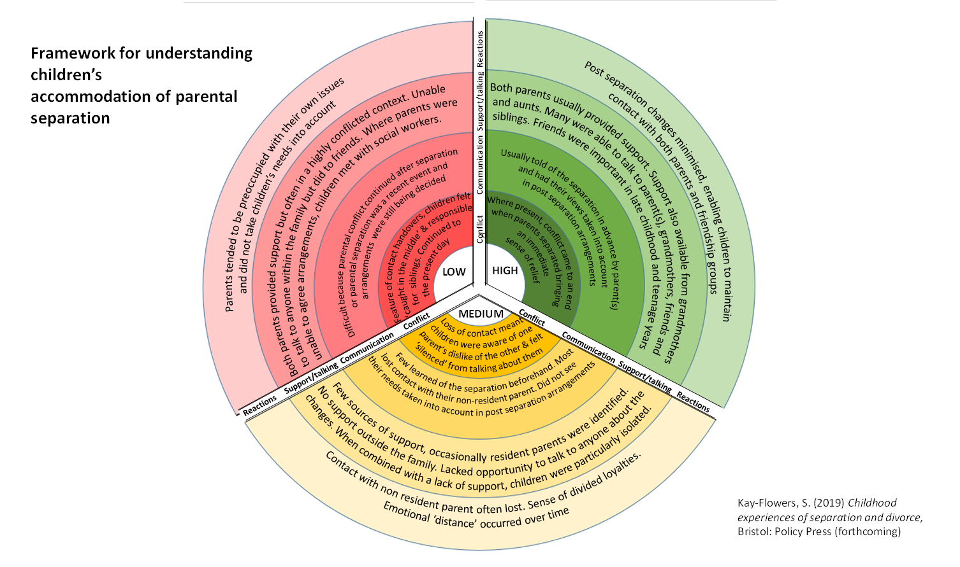

Slide 12
Use with parents
Awareness raising tool
Basis for discussion – to talk about what is happening in the family, offers prospect of reassurance
Promotes child centred approach – focus on child’s needs and listening to the child
To reinforce messages of young adults and support actions parents take to encourage higher level of accommodation
Informs parent(s) independent decision-making
In parenting classes
Notes:
Encourages parents to focus on child’s needs, to listen to the child and adopt a child-centred approach
Awareness-raising tool – parents could assess current position, identify areas where they could support their child and identify strategies
Basis of discussion to encourage higher level of accomm in long term (p177)
Use in parenting classes

Slide 13
Use in schools
Early indication of need for additional support
Home-school partnerships
Special Educational Needs Co-ordinators (SENCos), Pastoral staff and multi-agency interventions
Therapeutic use with child/ren
Forthcoming Relationships education curriculum
Notes:
Early indication – changes in child’s address, the quality of communication with parents, child’s network of friends. Could act as indicator child would benefit from additional support. Requires coordinated approach within whole school approach
SENCos, pastoral staff work at intersection of home and school and support children’s social, emotional and mental health well being
Therapeutic use with child – helping them to recognize own positioning on the framework and steps that could be taken to help themselves eg activities with friends, initiating conversation about separation with parents, individual activities
Forthcoming Relationships education curriculum (RSE in secondary schools) part of Personal, Social, Health and Economic (PSHE) curriculum – focus on ‘healthy relationships’ including ‘families’ and ‘people who care for me’ and will ‘help those children who are experiencing or witnessing unhealthy relationships know where to seek help and support

Slide 14





Current work
Framework has been shared with educational and social care practitioners working in schools, CAFCASS, a national charity, and with psychologists working in Nepal
Its usefulness in their work with children and families is currently being researched
A child friendly version of the framework for use by children in schools and other youth settings is under development

Slide 15
References
Denzin, N.K. & Lincoln, Y.S. (2011) ‘Introduction: The discipline and practice of qualitative research’ in NK Denzin, YS Lincoln (eds) The Sage Handbook of Qualitative Research, London: Sage
Kay-Flowers, S. (2019) Childhood Experiences of Separation and Divorce: Reflections from Young Adults, Bristol: Policy Press
Kay-Flowers, S. (2019) Framework for understanding children’s accommodation of parental separation: Appendix Six in colour available at: https://policy.bristoluniversitypress.co.uk/childhood-experiences-of-separation-and-divorce
Kay-Flowers, S. (2019) Here’s what young people say helped them get through their parents’ divorce, The Conversation, 04.10.19. Available at: http://theconversation.com/heres-what-young-people-say-helped-them-get-through-their-parents-divorce-121907
Any questions?
Email: S.J.Kay-Flowers@ljmu.ac.uk

